Slide 1

NUS Classroom4U NUS Fintech Dev II Project Team 4: Moses, Reginald Oh, Sim Teng Leong

Slide 2


NUS Classroom4U Service Platform
Students’ Database
Last, first Name Age Subjects Study Level Mobile number Email address
Match students (clients) to our in-house tutors.

Slide 3
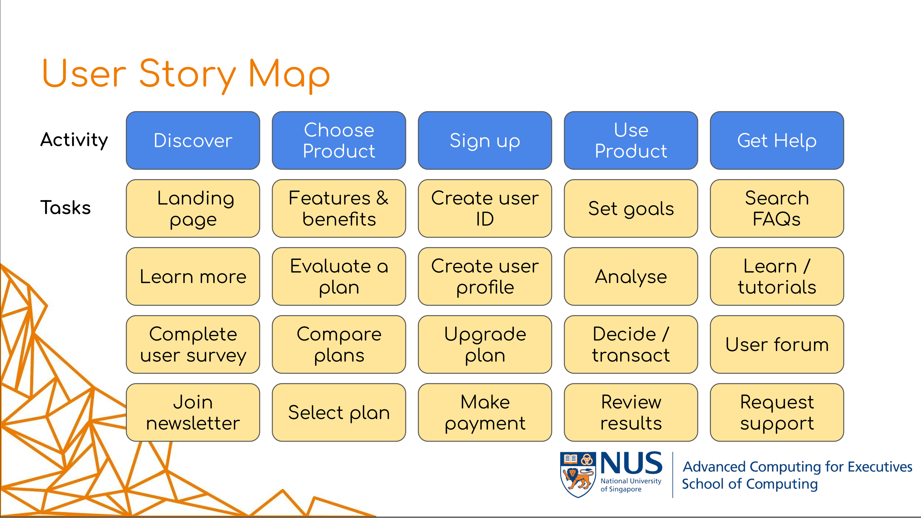
Service Platform Setup
Frontend Design:
?????
Backend Design:
When will we access the DB?
We are focusing on the “Discovery” stage of user story.

